Slide 1
PERFORMANCE MANAGEMENT

Slide 2
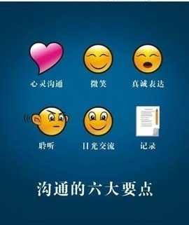
Performance management purpose
A process that helps people to communicate, so that they can align the organization's desired outcomes, as detailed in its business plan with their own individual development goals

Slide 3
Performance management cycle
Performance management is a continuous process cycle
Plan
(绩效计划)
Reward or PIP
(绩效奖励或改进)
Do/Execute
(绩效实施)
绩效沟通
Appraise
(绩效评估)

Slide 4
Performance management key factors
Key factors for a successful performance management
Management commitment and support
Mutual agreement on goals & objectives
Process is as important as the appraisal result
Effective communication
Coaching
Motivation
Development
There should be no surprises during the performance appraisal

Slide 5

Performance management
What should a manager do during the process
Manage as a continuous process
Provide timely and effectively feedback
Not only limited to official face to face discussion and meeting
Explain and emphasize expectations to team members
Solicit feedback from colleagues and clients

Slide 6

Performance management
What employee should do during the process
Get and understand your performance expectation
Get assignment or task
Seek for development opportunity
Obtain necessary resources for working
Ask for timely feedback on your performance

Slide 7
Performance Appraisal Timetable
GDC Performance Appraisal Contains
Probation review
New hire shall go through a probationary performance appraisal upon the completion of 3 months
Project review
Employees shall go through a project review when roll off from project
End Year review
All employees need to attend the End Year Review
People who in probation period is a exception
Review period 1/1 - 12/31

Slide 8

Performance Appraisal Points
All individuals
Achieving result
Client relation
Role and Technical Competence
Interpersonal Skills
Teamwork & Collaboration
Passion for Delivery
English comprehension
For managers and above
Managing direct reports
Business Development
Operation competency

Slide 9
Rules & Guidelines
Probation performance review should be delivered before the end of the probation period
Probation performance review can be combined with end year performance review if they fall at the same time
Project review should be closed and delivered within 30 days of a project assignment ending
Employees current PM or department head is responsible for leading the performance appraisal

Slide 10

Rules & Guidelines
361º feedback (360 means feedback from different sides including manager, co-worker, subordinate, clients, US colleague if appropriate, 1 means self evaluation which is must)
Provide evidence to support your rating and comments when provide feedback
Project review will be taken into consideration for annual performance review
Performance review result classification
Doesn't meet expectation
Sometimes doesn't meet expectation
Meets and sometimes exceeds expectations
Consistently exceeds expectations

Slide 11
Thank You !

